Slide 1
Treating Student Anger and Aggression:
Skills-Based Cognitive-Behavioral Approaches
Texas Association of School Psychologists 2014
Jim Larson, Ph.D.
Professor Emeritus
Department of Psychology
University of Wisconsin-Whitewater
Contact: larsonj@uww.edu

Slide 2
Today’s Agenda
Theoretical underpinnings of reactive aggression
Screening, identification, and progress monitoring for anger treatment
CBT orientation and generalization issues
Anger management group program (8-12)
Anger management group program (13-18)
Treating individual students

Slide 3
Learning Objectives
At the conclusion, workshop participants will be able to:
describe the cognitive and behavioral characteristics of reactive aggressive children and adolescents;
describe procedures for screening, identification, and progress monitoring;
describe the essential elements for the group and individual treatment of children and adolescents experiencing behavior problems associated with reactive aggression

Slide 4
Videos
All therapy videos from this workshop may be downloaded at:
http://facstaff.uww.edu/larsonj/video.html
Click “?” first and follow directions

Slide 5
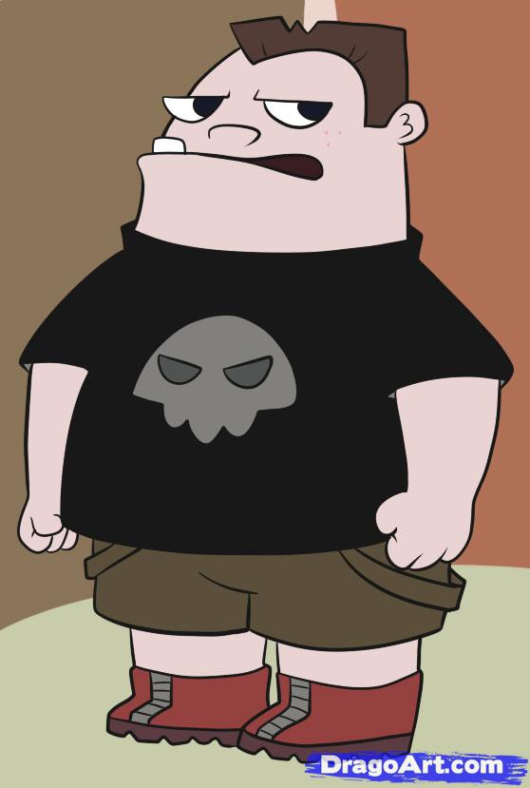
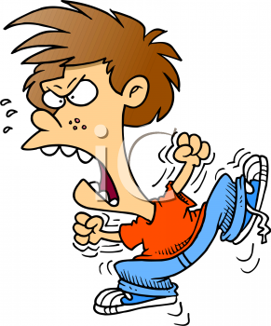
Two Acquaintances
Butch
Ducky

Slide 6
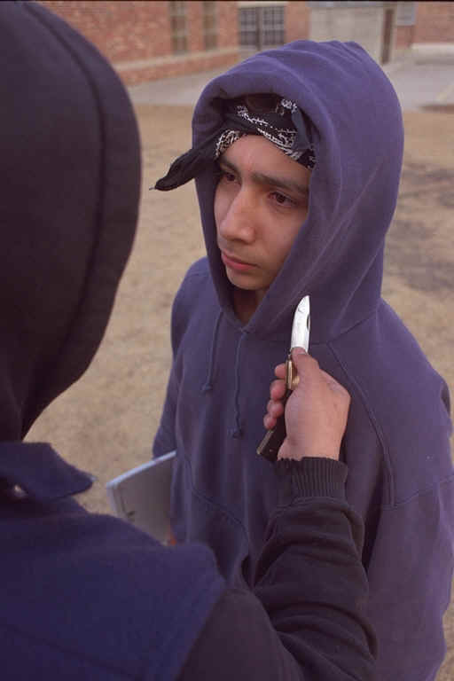

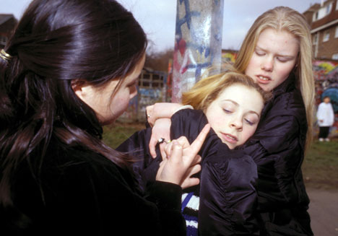
Proactive/Premeditated Aggression
  goal-oriented aggressive behaviors; want something
  cool-headed, bully-type; gang leadership
  overvalued use of aggression
  managed best with effective security measures

Slide 7
Video
https://www.youtube.com/watch?v=X9_WwuGF4dM
What was the trigger?
  Event?
Student response?
Principal response?
Teacher response?
What might have changed the outcome?
What if the principal sent him to your office the next day?
Notes:
Feelings?Thoughts? Behaviors? For all three-

Slide 8

Reactive/Impulsive Aggression
Unplanned, impulsive
Hot tempered, easily riled
Show less control over emotions
Numerous social-cognitive deficits
The focus of today’s workshop

Slide 9
Goals of School-Based Intervention
Interrupt the downward spiral of academic and behavioral engagement
Train new cognitive-behavioral skill sets for addressing trigger events
Begin the formation of adjusted school-based schemata to foster increased confidence and competence
Notes:
Introduce slide: This is not a fix all, it’s one intervention to address a specific need.
Point 1. For many kids, this spiral began the first day they walked into Kindergarten. Many think ‘this is the best day of my life! It’s going to be so fun!’ but for some it ends up being the worst day. Everything they had been learning is WRONG and will get you into trouble. The rules have changed. The cultural environment is entirely new. These kids had NOT been learning letters, colors, shapes, and had NOT been listening to stories or watching Discovery channel, and had NOT been following rules. By the time we get them in 4th or 5th grade, they have already been turned off to education and the spiral toward negative behavior has sped up.
Point 2. Want to train new skill sets. Most kids can comply; however, there are those that don’t like to be told what to do, esp. in front of their friends. We want to help them manage triggers that set them off (i.e. confrontation with teachers).
Point 3. We want to get adults smiling at you (the student). Their already thinking…not going to happen today. Need to build a belief in themselves – “I CAN finish that worksheet.” Students are watching to see if their skill level has increased and they become excited to see it happen.
We need to go into this with our eyes open. Think, “I’m going to change a big chunk of them… but not all”
9

Slide 10
Risk Factors for Child Disruptive Behavior Disorders
Notes:
10

Slide 11
What is the course of aggressive behavior in childhood?
Frequency of physical aggression steadily decreases from age 2 to 12 (Tremblay & LeMarquand, 2001)
Notes:
With preschoolers, if someone takes a toy almost all kids react – hit, grab, or even bite. This is normative. This aggression decreases over time because verbal skills increase
11

Slide 12
Is Aggressive Behavior a Stable Pattern?
Subgroup of chronic aggressive children are at risk of most physical violence during adolescence (Nagin & Tremblay, 1999)
Notes:
This subgroup tends to be the kids with lower verbal skills and those with ADHD. Because one needs to stop and think to make a non aggressive response, hyperactive kids particularly have a tough time making this transition.
12

Slide 13

The Interaction and Potentiation of…
Poverty
High risk pregnancy
  Young, poor nutrition, low birth weight
  Possible substance abuse sequelae
Difficult temperament
Coercive parenting style (Patterson et al.)
  Limited discipline responses
  Poor child monitoring
  Attack-Counterattack -Positive Outcome
  Escalating counterattacks
Notes:
Tobacco -- emotion regulation problems and Inter-Uterine Growth Retardation
Cocaine – aggression
http://www.socialsciences.leiden.edu/educationandchildstudies/clinicalchildandadolescentstudies/neurocognitive-development/research/prenatal-risks.html
Difficult Temperament – strong genetic predisposition; Chess and Thomas’s work ;
Fussy, demanding, hard to warm up to

Slide 14
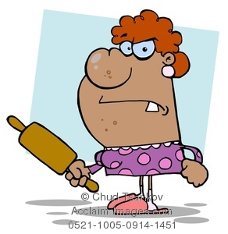
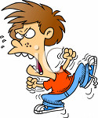
Attack – Counterattack – Positive Outcome
“All right! All Right! Take it easy! Just keep the noise down, okay?"
“Stop hitting your sister!”
“No! She started it!!”
Parent makes a compliance demand
Mother’s escape behavior is reinforced & child’s antisocial behavior is reinforced
Repeat.…

Slide 15
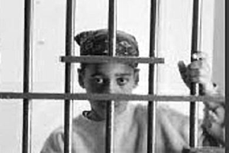
The Path Continues…
Poor readiness and peer rejection in school
Co-morbid ADHD, ODD, SLD, trauma
Academic difficulties, retention, and/or special education
Poor or missing interventions
Middle -Exposure to high risk or deviant peers
Lack of prosocial models and supervised community activities
Alcohol, drugs, and weapons

Slide 16
These risk factors can produce…
Students with pro-aggression schema and negative affiliation schema
Students who lack an adequate sense of academic self-efficacy and possess accompanying counter-productive learning habits
Students who possess problematic cognitive deficits and distortions
Students who “think fast” far too much

Slide 17
Automatic Processing
Daniel Kahneman’s Thinking, Fast and Slow
  System 1 (fast) and System 2 (slow)\
Automatic Processing
  Quick, no effort, suppresses ambiguity & doubt
  Focuses on existing evidence & ignores less salient evidence
  Confirms existing beliefs
Automatic processing has value…
…but not when DELIBERATE processing is needed

Slide 18

Effects of Automatic Processing on Problem Solving
Memory Bin
Response Enactment
Stimulus
Perceived Threat
Direct Action
Direct Action
Verbal Assertion
Help Seeking
J. Lochman
Notes:
IF can wait 20 secs, then will possibly be able to pull up a more adaptive solution—get better at it.
18

Slide 19
Effects of Deliberate Processing on Problem Solving
Memory Bin
Response Enactment
Stimulus
Perceived Threat
Direct Action
Verbal Assertion
Verbal Assertion
Help Seeking
Notes:
Our goal is to get some of those ‘other strategies’ (like verbal assertion) in their memory bin to the top of the stack of choice so it becomes more automatic. This done through practice and repetition.
19

Slide 20
Effects of Automatic Processing on Problem Solving
Memory Bin
Response Enactm
Stimulus
Response Enactment
Perceived Threat
Verbal Assertion
Verbal Assertion
Direct Action
Help Seeking
Notes:
With rehearsal, don’ t need the 20 seconds anymore. Get the appropriate response further up in the memory bin!! No longer need 20 secs to get them to rely on Verbal Assertion.
20

Slide 21
Effects of Deliberate vs Automatic Processing on Problem Solving
Both aggressive and nonaggressive boys who use automatic processing produce 50 % fewer verbal assertion solutions and three times more direct action solutions than when they use deliberate processing (e.g. instructed to wait 20 seconds before responding)
  Lochman, Meyer et al. (1991)
Notes:
When we talk about solutions, many of us come up with an aggressive solution if we don’t stop and think first. Both verbal assertion and help seeking are in your memory, but if you don’t stop and think you cannot access them.
EXAMPLE: DRIVING: When you were on the way here today, bad weather/running late. Someone cuts you off. What is your immediate response? Some of us may be aggressive-swear/throw the finger etc. Let’s try imagining that situation and then I am going to ask you to wait 20 seconds. Count to 20 slowly. What might you do now?? What did that feel like? 20 seconds is too long! Can’t wait 20 secs. Instead-need to think about how to move into the memory bin.
21

Slide 22
QUESTION
How do we design an intervention that will increase the probability that the student will engage in deliberate processing and make wiser personal decisions?

Slide 23
Social Information Processing
(Dodge, 1991; Crick & Dodge, 1994)
OCCURING IN A SPLIT SECOND…
attend to available social cues
give meaning to the cues
select desired outcomes
Generate possible responses
Identify potential consequences of a response
act out selected responses
Hallway passing stimuli, brushed on shoulder
Scan memory; Prior hallway experiences
Avoid trouble; Get to class on time
Call him out; Keep moving to class
Possible trouble; Get to class w/out incident
Think about something else and head for class
Notes:
To the audience – “You are attending to my voice now. You’re going to learn something. You take notes to meet that goal.”
The kids we are talking about have processing deficits. They don’t deal well with these 6 steps.
Jim’s joke: “I know you do well with these steps, because you’re not in jail ☺”
23

Slide 24
Social Information Processing Deficits in Reactive Aggressive Youth
(Dodge, 1991; Crick & Dodge, 1994)
attend to available social cues
give meaning to the cues
select desired outcomes
Generate possible responses
Identify potential consequences of a response
act out selected responses
Hypervigilant for aggressive cues
Hostile attributional biases
Higher value on retaliation than affiliation
Narrow solution generation abilities
Tendency to evaluate aggression positively
Difficulty enacting prosocial skills
Notes:
To the audience – “You are attending to my voice now. You’re going to learn something. You take notes to meet that goal.”
The kids we are talking about have processing deficits. They don’t deal well with these 6 steps.
Jim’s joke: “I know you do well with these steps, because you’re not in jail ☺”
24

Slide 25
Reactive Aggressive Youth
Implications for Treatment Interventions
Social-Cognitive Deficit
Hypervigilant for aggressive cues
Hostile attributional biases
Higher value on retaliation than affiliation
Narrow solution generation abilities
Tendency to evaluate aggression positively
Difficulty enacting prosocial skills
Training Focus
Train verbal & nonverbal cue recognition
Attribution re-training
Consequential thinking
Solution generation skills
Perspective-taking development
Behavioral skills training
Notes:
Point 1. Reactive kids look for someone rolling their eyes or that shoulder bump, -they are looking for hostile cues.
Example – you’re walking down the hallway and you accidentally bump someone. You turn around and (trainer holds palms up and mouths the word ‘sorry’). Reactive kids do not pay attention to the cue of hands up, rather they are still focused on the shoulder bump.
Point 2. This is the tendency to judge a neutral stimulus as hostile
Point 3. They have a great desire to get back and someone than to make friends. The teacher may say ‘make up and shake hands’ but these kids later will want to get even.
Point 4. Example. Driving down the highway and someone ahead of you is driving 20 miles/hour below the speed limit. Many possible solutions: lay on the horn, flip them off, bump up behind them…. but I took a deep breath
Show video – boy dribbling a soccer ball and another boy comes and kicks the ball into the street. What to do? I’ll beat the crap outta him! I’ll kick his head in! I’ll get my cousin to… Want to get kids to a point that they see value in assertive but non aggressive responses – “hey, go get my ball”
What we do in these interventions is help kids look at and think about the consequences
We usually tell kids to ignore, or take a deep breath. They SAY they can do it, but in action they cannot.
Example – If our training today were about how to fly, I could get you to the point that you would pass the (written) test. You can learn all ABOUT flying an airplane but not how to actually DO it. We need to TEACH these kids through practice, practice practice…
TRAINING FOCUS
- You all know when you’re getting angry and then you regulate
- You think about the situation – could it have been an accident (that so and so did that)? Maybe he confused me with someone else.
(consequential thinking) If I do this then what would happen?
(sol’n generating) What could I do?
(Persp) What might she have been thinking? If you were that teacher what would you be thinking. (this is the first step in empathy development)
(skills training) actually TEACH them things such as being assertive. These are skills they do not know
25

Slide 26
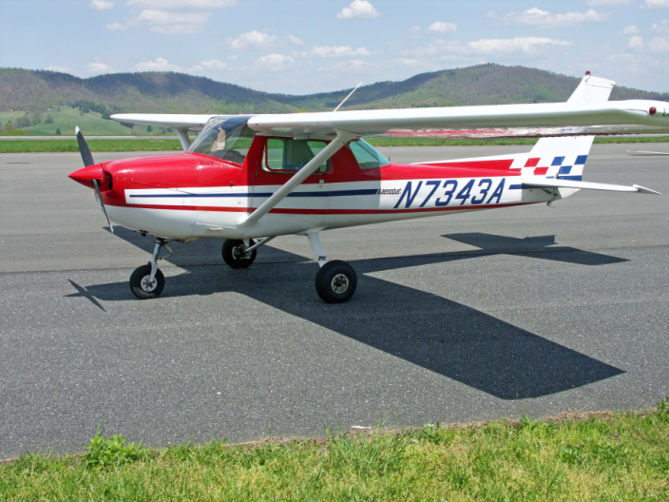
Knowing THAT vs.
Knowing HOW
Knowing about a new behavior is NOT the same as being able to enact that behavior under rapidly moving conditions of ambiguity and emotion
Flight Instruction

Slide 27

Questions or Concerns?
Notes:
27

Slide 28
Understanding the Students’ Anger
(Hint: It’s sorta like yours, but…)

Slide 29
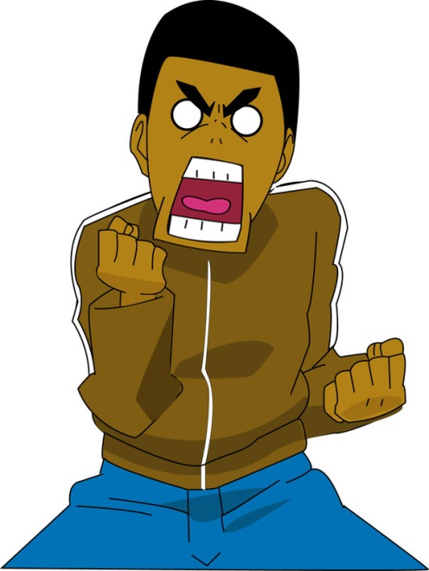
What is Anger?
A normal human emotion
Wide range of intensity and demonstration
  Humans hard-wired for anger
  Survival function/Corrective action
  Continuum from mildly annoyed to seriously enraged

Slide 30
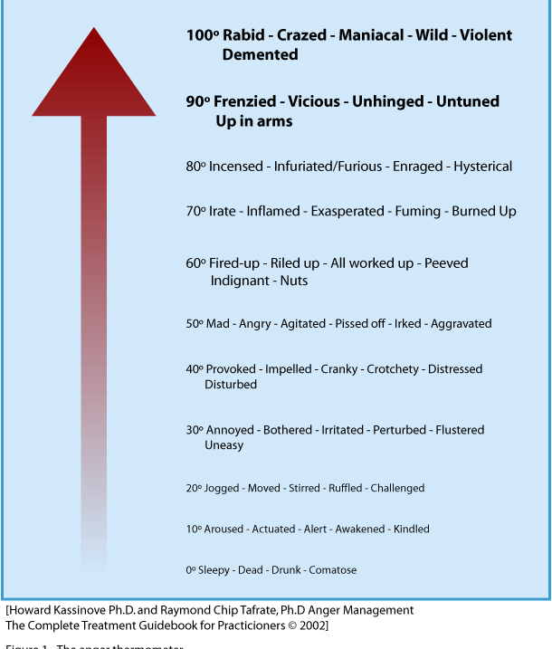
Anger Thermometer
Kassinove & Tafrate, 2002

Slide 31

When Does Anger Occur?
A threat to your (or loved one’s) physical well-being
A threat to your self-concept (“How dare he!”)
Reaction to your unmet demands (“I told you not to do that!”)
Reaction to being offended/dissed
Reaction to being denied

Slide 32
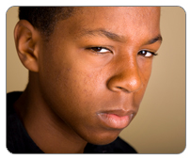
What is the Purpose of Anger?
It energizes behavior, increasing the level of responding
It focuses attention on the threat
It communicates displeasure to prompt conflict resolution
It signals information about personal state
It dramatizes a social-role enactment
Novaco, 2007

Slide 33
The 3 Components of Anger
The FEELING part
  Your physical sensation of becoming or being angry
The COGNITIVE part
  What you choose to say to yourself
The BEHAVIOR part
  How you choose to express yourself

Slide 34

The FEELING part
Generally the first indicator
Physiological arousal through rapid hormone release
    Limbic system function
Heartbeat, blood pressure, flushing, muscle tension

Slide 35
The COGNITIVE part
Your identification of the arousal
    Neocortex function – Label it
Your choice of self-talk
    Based on incoming sensory data and firmly held beliefs
    Threat, fairness, offense, rights

Slide 36

The BEHAVIOR part
Communication function
Aggression initiation function
Threat-stopping function
Conflict resolution function
Script enactment function

Slide 37
The 3 Components of Anger
The FEELING part
  Your physical sensation of becoming or being angry
The COGNITIVE part
  What you choose to say to yourself
The BEHAVIOR part
  How you choose to express yourself

Slide 38
Like you, except that….
…students with problem anger and aggression:
  Over-label emotional arousal as “anger”
  Fail to recognize internal anger cues
  Lack experience with mild anger
  Lack effective anger regulatory skills
  Tend to read environmental cues inaccurately
  Engage in WYSIATI problem solving
  Lack useful alternatives to anger displays
  Are more immersed in peer anger modeling

Slide 39
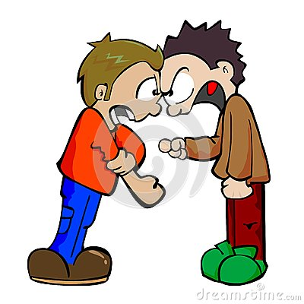
When is Anger a Problem?
In the context of location…
Frequency
Intensity
Duration
Mode of expression

Slide 40
Anger and Reactive Aggression
Cognitive, affective, and behavioral aspects
  Anger cognitions; demandingness; fairness
    You don’t get from anger to aggression without the cognitive attribution of intentionality
  Physiological sensation of anger
    Tendency to over-label arousal as anger
  Aggression - verbal, physical, otherwise
Interventions should focus on all three
Notes:
.”
40

Slide 41
Small Group Interventions
with
Angry, Aggressive Girls

Slide 42
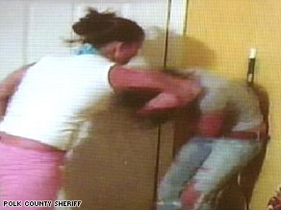
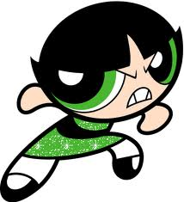
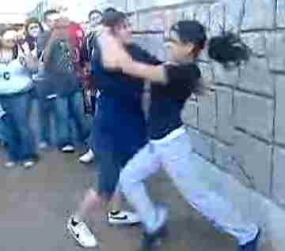

Rates of arrests for assault among girls have climbed steadily since the 1990’s
180,000 murders, rapes, armed robberies, and assaults on TV over typical childhood viewing period (Garbarino, 2006)

Slide 43
Aggression in Girls
Physically aggressive girls are at comparatively higher risk as a group
  Favor aggressive boys
  Begin sexual relationships early
  High risk for physical abuse
Most of their fighting is about boys or about perceived disrespect
Girls who have been physically and/or sexually abused in the home are at increased risk to be physically aggressive in school

Slide 44
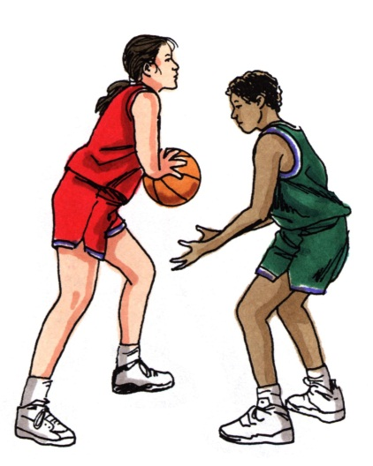
Reactive Aggression in Girls
Girls can exhibit reactive aggressive patterns similar to boys
Nature of other girl anger forms may be qualitatively different from many boys
  Relational aggression
  Greater tendency to hold prolonged grudges

Slide 45
Screening, Identification, and
Managing Grudges
Discuss their friendship and “enemy” relationships with the classroom teachers.
Ask each individual girl who she “likes least” and “likes best” among the girls in the school. Make note of reciprocated nominations of mutual dislike.
Examine office discipline records
Within the group, seek to establish a “peace zone”
Notes:
Consider of taking a survey and having them rate who they like the most and the least. Look for reciprocal nominations of least. Can also check school records of who’s fighting with whom.
“peace zone” – see if they will agree to be “OK” with each other at least during group time.
45

Slide 46
Victimization Issues
High likelihood of previous or ongoing physical or sexual abuse; ASSESS!
Some training activities (e.g., the taunting exercise) may be contraindicated for children with PTSD or anxiety concerns
Consider providing physical self-defense training http://www.justyellfire.com/index.php
Be alert for co-occurring depression
Notes:
46

Slide 47
Tier 2 Small Group Skills Training
Screening, Assessment, and Identification

Slide 48
Three Levels of Social and Emotional Support in School
INDICATED
SELECTED
UNIVERSAL
FEW
Individual Clinical Support - PSD
SOME
Anger Coping & Think First
ALL
SEL & Discipline
Notes:
48
?
At the SECONDARY level, we are concerned with those students who are showing signs or symptoms of mental health problems. What do these students need know and be able to do to stop or reverse the progression of the problem?
At the TERTIARY level, we are concerned with the needs of those students with severe and pervasive mental health problems. These students are typically, but not always, is special education. We are concerned with assisting in the teaching of coping skills and facilitating transitions.

Slide 49
General Considerations
Remember your tier…
Energize/actualize Tier 1 supports if necessary, incl. point of performance interventions in classroom & elsewhere
Determine if aggression/anger regulation is “can’t do” or “won’t do”
Watch for false positives
Correct attendance problems first
Screen for trauma, depression, substance

Slide 50
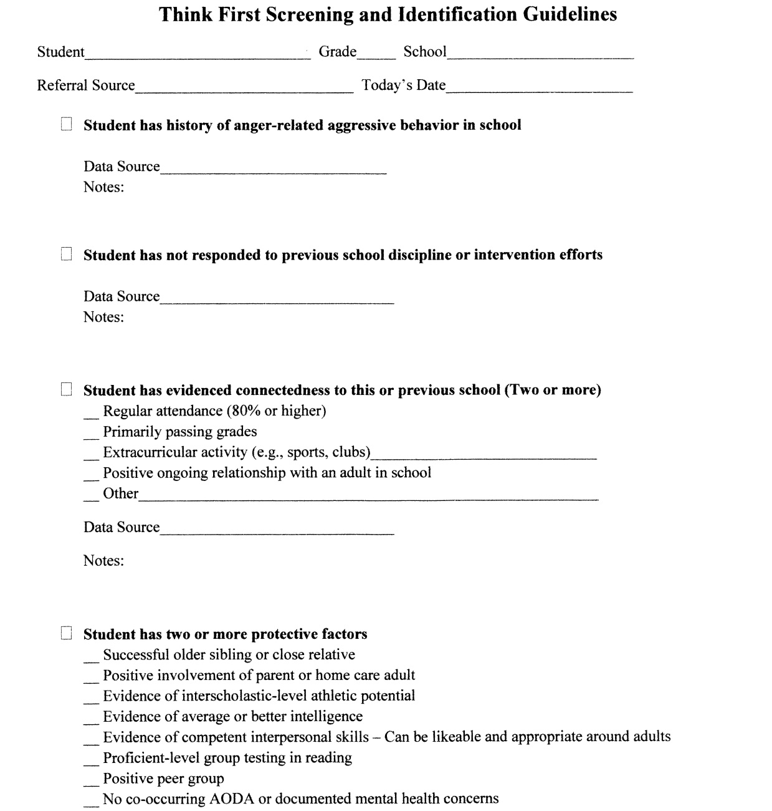
Adolescent Screening Guide

Slide 51
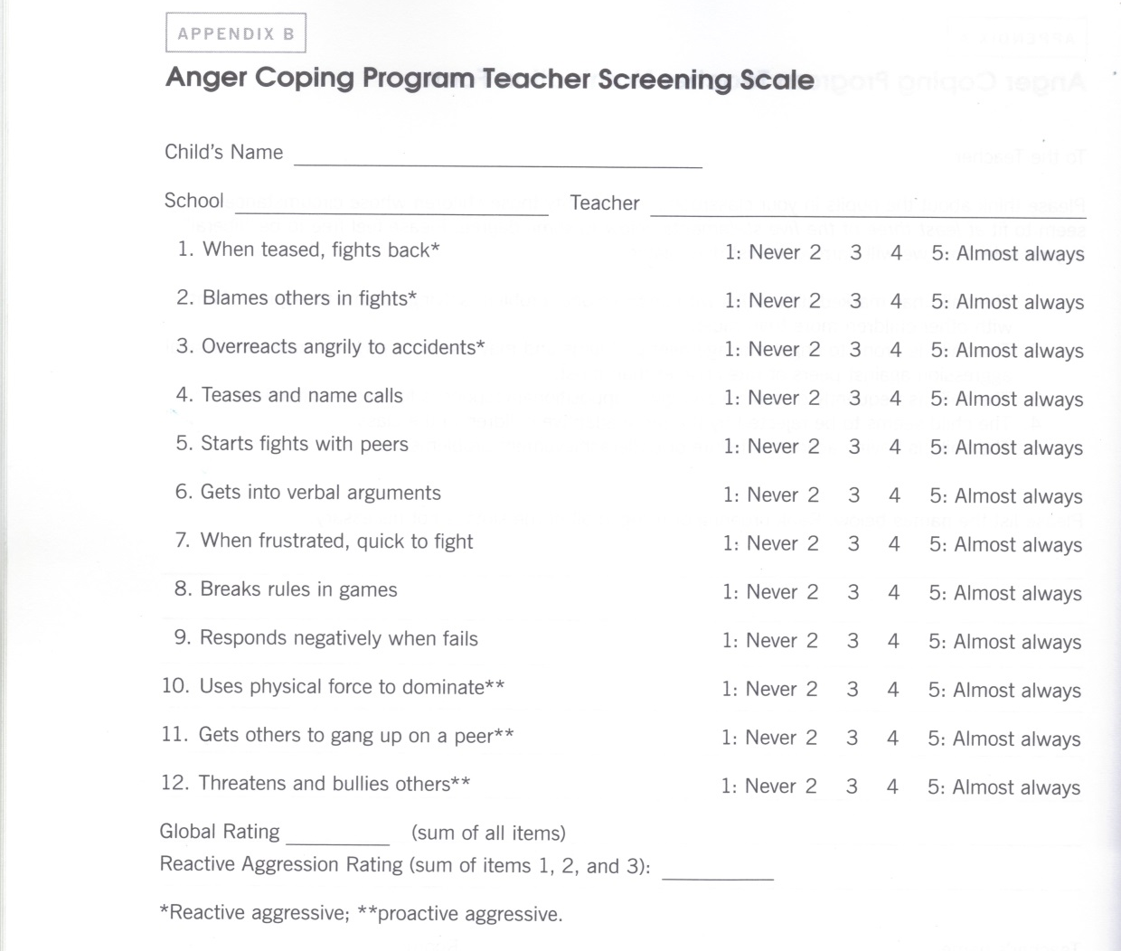
Elementary/Middle Screening Scale

Slide 52
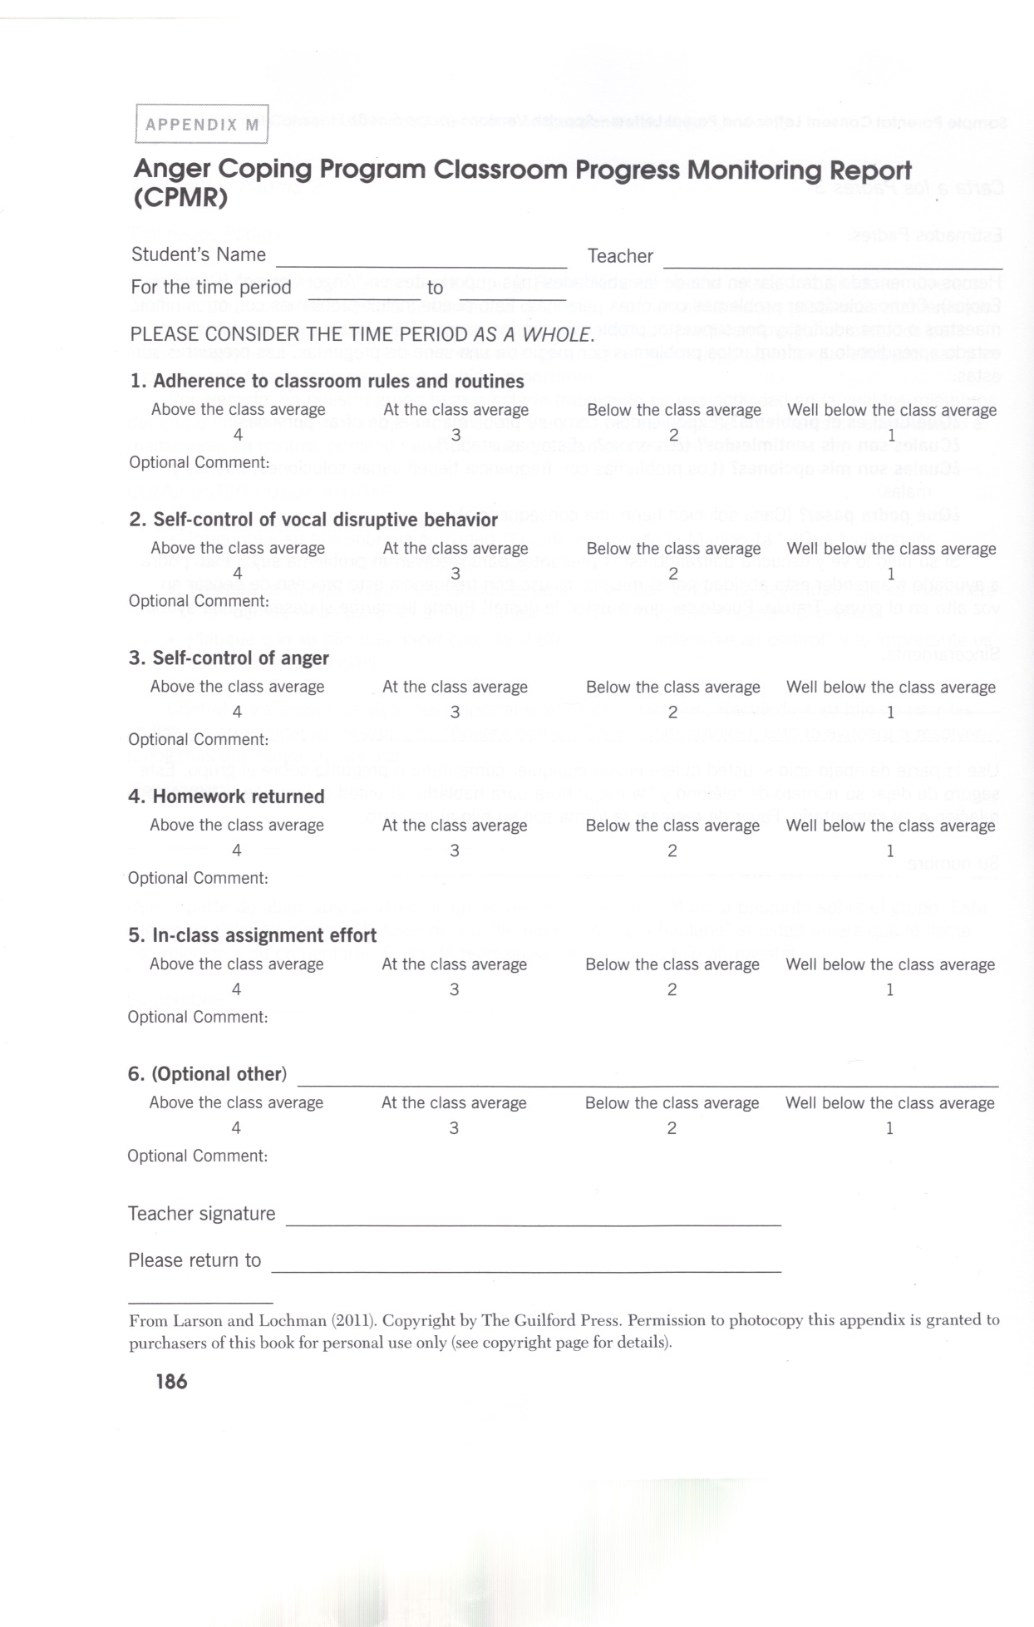
Classroom Progress
Monitoring Report

Slide 53
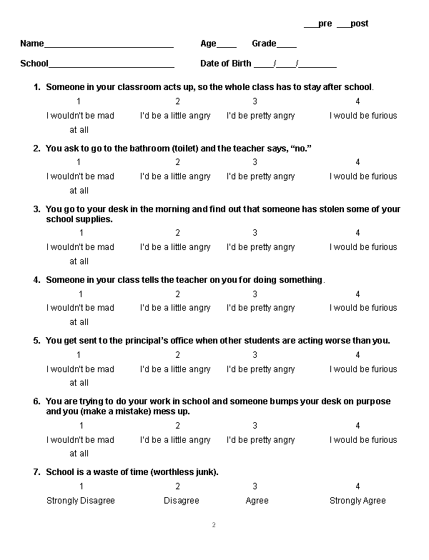
Multidimensional School Anger Inventory
Mike Furlong and Doug Smith
http://www.michaelfurlong.info/msai/

Slide 54
Progress Monitoring Baseline
  Need to establish a behavioral baseline
  How will we know it’s “working?”
  What is he/she doing that is observable, measureable, and subject to change?
    Authentic data from home or school
    Increase something or decrease something
    Disciplinary reports, home/school/unit point system
    Classroom Progress Monitoring Report
    Use of “Direct Behavioral Rating” (DBR)

Slide 55
Psychometric Baseline Data
Can also be report data from self, parent, or teacher instrument
  E.g., Achenbach CBCL or BASC-2
  See http://www.fasttrackproject.org/data-instruments.php
    Numerous instruments for download
  Strengths and Difficulties Questionnaire
    Child, Teacher, and Parent forms w/scoring templates
  http://www.sdqinfo.com/

Slide 56
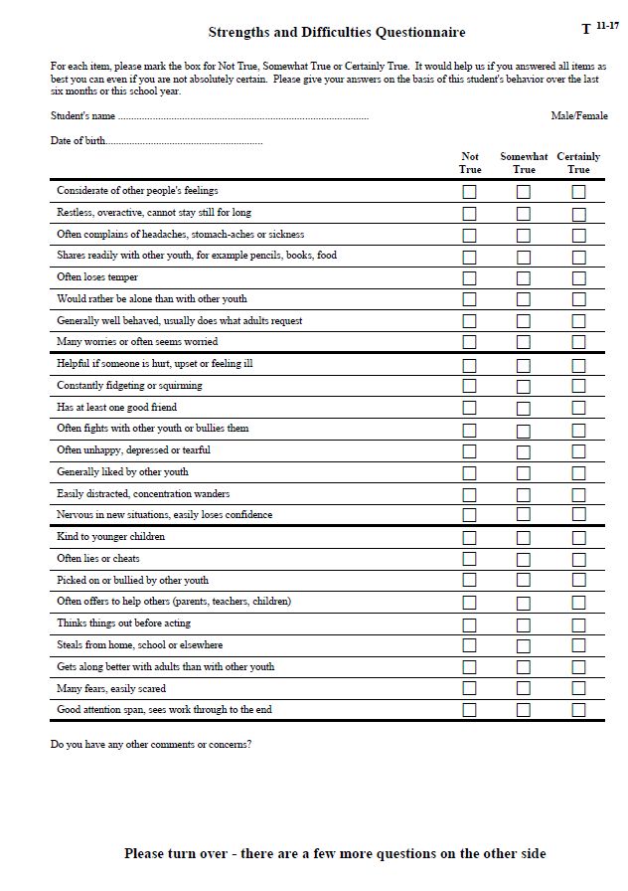
Strengths and Difficulties Questionnaire (SDQ)
Also, the Classroom Progress Monitoring Report

Slide 57
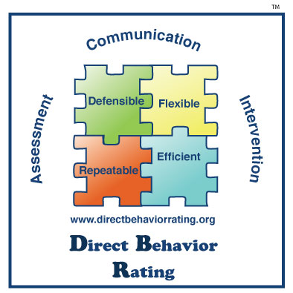
Direct Behavior Rating
http://www.directbehaviorratings.com/cms/

Slide 58
Monitoring Progress and Evaluating Outcomes
Goal Attainment Scaling
Percentage of Non-Overlapping Data (PND)

Slide 59
Goal Attainment Scaling
GAS Form for… | Period covering… | Behavior…
+2 Much more than expected | 1 2 3 4 5 …
+1 Somewhat more than expected | 1 2 3 4 5…
0 Expected level of Outcome | 1 2 3 4 5
-1 Somewhat less than expected | 1 2 3 4 5…
-2 Much less than expected | 1 2 3 4 5…

Slide 60
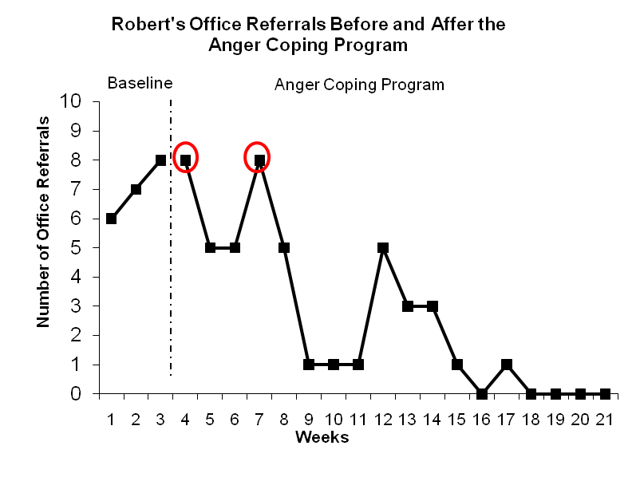
Sample PND
Obtain at least 3 data points in baseline phase
overlapping data
PND = 16/18 = 88.9%
PND of 90 or greater is considered highly effective, 70-90 moderately effective, 50-70 questionably effective, and 50 or lower is ineffective (Jenson, Clark, Kircher, & Kristjansson, 2007)

Slide 61
PND Tool
See Intervention Central’s
ChartDog Graphmaker at:
http://www.interventioncentral.org/tools/chart_dog_graph_maker

Slide 62
Generalization
The transfer of insights and behaviors from the therapy room to the natural environment so as to facilitate adaptive participation and positive growth
The maintenance of these skills over time and across environments and situations
  See Donald Meichenbaum - http://www.melissainstitute.org/documents/Silence3-Meichenbaum.pdf

Slide 63
Facilitating Generalization
Collaborate on behavioral goals
Care for your therapeutic relationship!
Identify generalization agents (teachers, etc.)
Create an expectation for change
  Design mini-experiments
  Problem-solve barriers to change
Near the end, address relapse issues and mutually design supports

Slide 64
Rapport: Readiness for Change Motivational Interviewing - Miller & Rollnick, 2002
Most people resolve most of their own problems naturally
  Want to make a change: How important is it?
  Able to make a change: Perceived ability
  Ready to make a change: Timing & priorities
Stages for therapeutic change mirror that of natural change
  Your clients must be ready, willing, and able

Slide 65
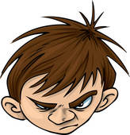
Building Rapport with Angry, Aggressive Young Clients
Take a “collaborative stance”
  Together we can make life easier
  “What do YOU want to change?”
  “How can I be of help to you?”
  “Where’s the best place to start?”
“Join” client’s angry concerns
  “Sounds like you have a pair of problem parents!”
  “I’d hate that school, too! What can we do about that?”
Gently challenge irrational “have to’s” of treatment

Slide 66
CBT Orientation
Use of cognitive techniques (e.g., self-instruction) in combination with behavioral techniques (e.g., behavioral rehearsal)
Preference for current reality over remote explanations
Manualized delivery, but….
“Flexibility within Fidelity”

Slide 67
CBT Orientation
What does the client need to know?
  E.g., Most behaviors are choices
What does the client need to be able to do and under what conditions?
  E.g., Regulate anger and respond non-violently when provoked by peers on the bus
How do we facilitate the acquisition of that knowledge and those skills?

Slide 68
CBT Orientation
Therapist stance is that of a “supportive coach” -- teaching, conducting practice, and providing encouragement
A “metacognitive prosthetic device” rather than a “surrogate frontal lobe!”
Best book? Stress Inoculation Training by Donald Meichenbaum; Next? Child and Adolescent Therapy (4th Ed.) by Philip Kendall

Slide 69


TREATING CHILDREN AGES 8-14 USING THE ANGER COPING PROGRAM

Slide 70
Overview of Anger Coping Program
Session 1: Introduction
Session 2: Goal Setting
Sessions 3-7: Anger Awareness and Management
Sessions 8-10: Social Problem Solving
Sessions 11-18: Video Production

Slide 71
Overview of Anger Coping Program
Developed by John Lochman, Ph.D. (now at U. of Alabama) and colleagues. See citations in References section.
Manual available from major online booksellers or publisher:
Larson, J., & Lochman, J. E. (2010). Helping schoolchildren cope with anger: A cognitive-behavioral intervention (2nd ed.). New York: Guilford Press

Slide 72
Group Treatment in School, Residential Facility, or Clinic Setting
Identify generalization agents (e.g., teachers, residential unit staff, parents)
  Who has most contact in critical other environment?
Involve agents in identification and selection to foster collaborative treatment relationship
  Avoid simple “time keeper” roles
Assess possible levels of agent involvement
  Skill level, interest, time commitments

Slide 73
Role of Classroom Teacher(s)
Critical partners in Anger Coping Program
Assist in screening and identification
Provide child background information, including favored reinforcers
Evaluate weekly goal attainment
Consult weekly with skills trainer about child behavior
Manage transfer of training of skills learned in small group

Slide 74
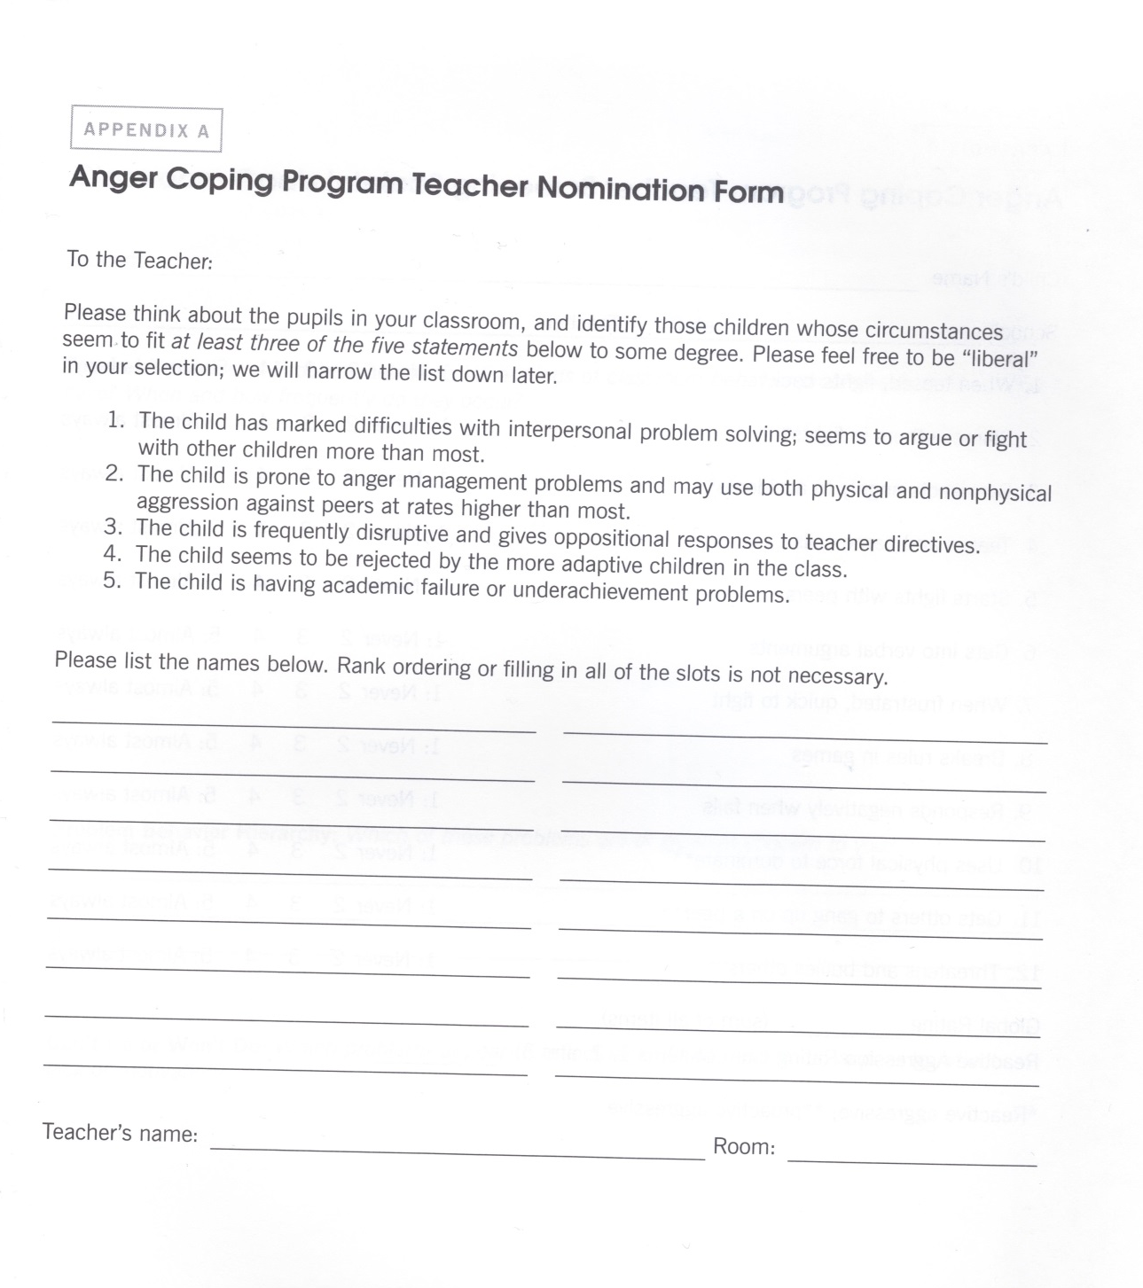
Teacher Nomination Form
P. 165
Need at least 3 of 5 statements

Slide 75
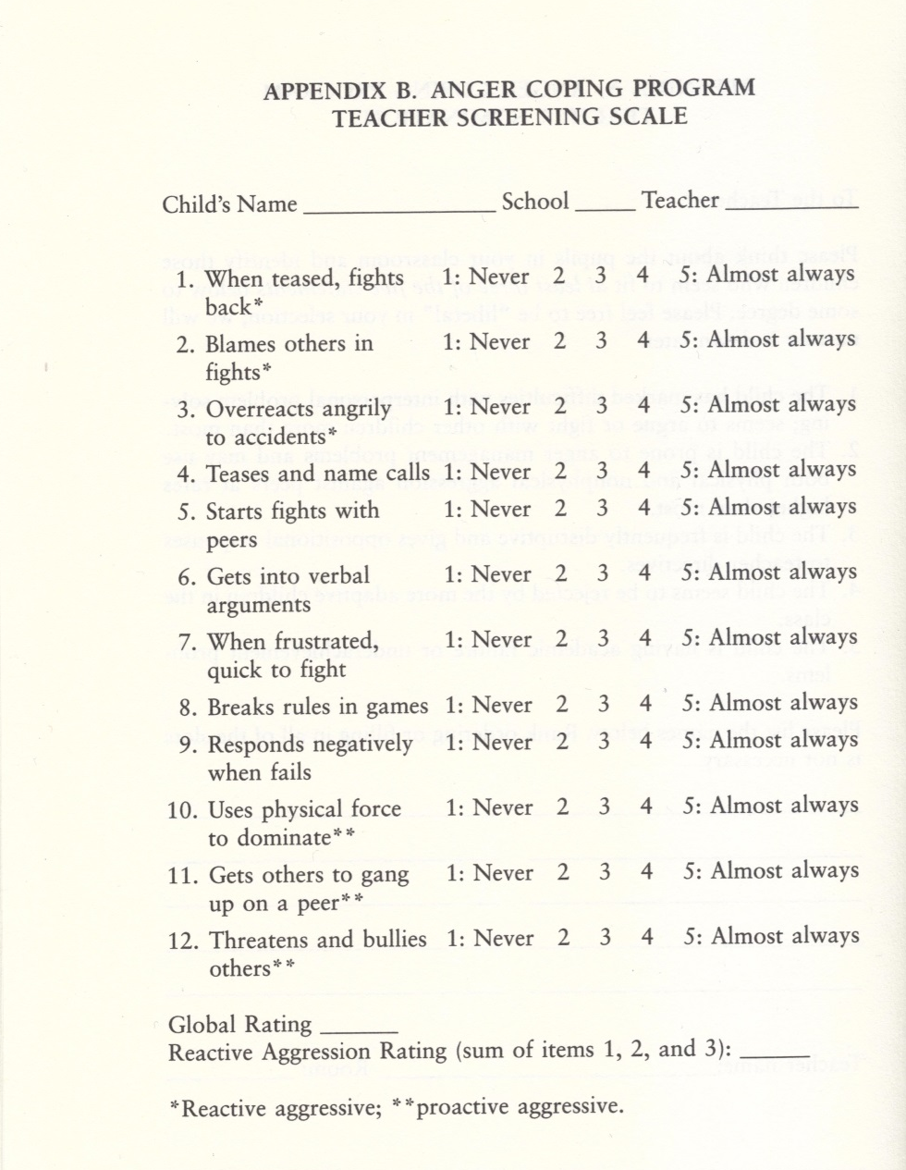
Teacher Screening Scale
Reactive
Proactive

Slide 76
FOSTERING the Collaboration
Foster sense of teacher ownership in the program by:
  Involving them in the selection of children
  Obtaining their input about children's behavioral needs
  Keeping them informed about what the children are learning in group
  Provide examples of how agents can facilitate generalization of skills in the classroom or residence
  Elicit suggestions for reinforcers (teacher’s helper, homework pass, dinner choice, TV choice)

Slide 77
FOSTERING the Collaboration
  Frame the program as serving their needs by addressing disruptive behavior
  Refer to “OUR” Anger Coping Group
  Work with teacher on best times for group meetings, but be assertive regarding the value of what you are doing
    Many teachers will undervalue any activity that is willing to meet during lunch hour or recess
    Socio-emotional learning is at least as important as reading or math for these selected children

Slide 78
Getting Started:
Group Composition
6 to 8 children
Similar age range, with related presenting problems (i.e., disruptive behavior)
Exclude children who are
  Likely to pose substantial challenges to group behavior management. Work with individually first.
  Substantially different from the proposed pool of group members (age, gender, developmental level)

Slide 79
Getting Started:
Prior to Each Session
Review the session content in manual – allow enough time to review prior to session to ensure time to gather any required materials
Review fidelity monitoring forms for the specific session and previous sessions
Discuss leader roles with co-leader, if nec.
Prepare materials

Slide 80
Getting Started:
Preparing for the First Meeting
Schedule group time (45-60 minutes)
Identify group meeting space
Assemble materials:
  Binders/folders for children
  Goal sheets
  Posters
  Prize box/incentives (see manual for free reinforcer list)
  Activity materials

Slide 81
Point System
Individual Points
  Behavioral Goals
  Participation
Group Point
  Teamwork
Optional Points
  Good transition to/from classroom
  Additional points for quizzes, games, and homework assignments

Slide 82
Group Incentives or “Teamwork Points”
Common goal for all group members to work together to achieve; minimizes “scapegoating”
Often associated with final session “graduation” but can utilize multiple group rewards if helpful for promoting group cohesion or addressing specific goals
  Attendance (group or school)
  No discipline reports for group members
  Returning Goal sheets
Notes:
Rationale: helps minimize “scapegoating” of one group member; promotes group cohesion and cooperation

Slide 83
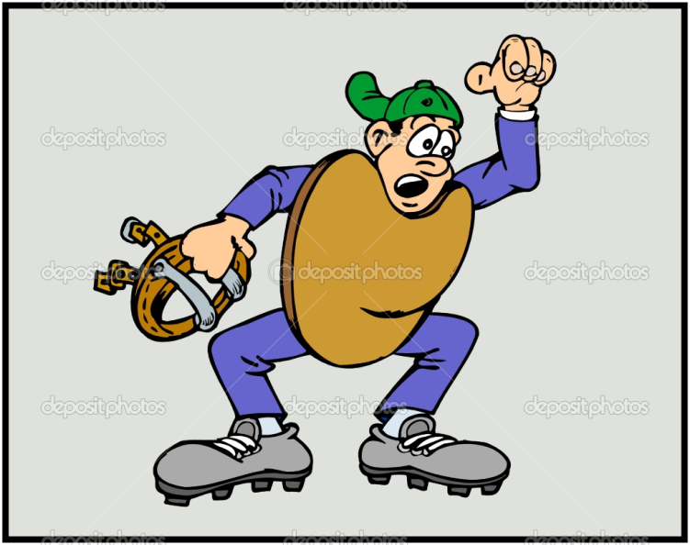
Strike System
Response cost procedure
Strikes given as warnings for rule violations
3 strikes – Time-out or loss of day’s points
Emphasize a strike is a warning
Intentionally give strikes during first few sessions to shape group behavior

Slide 84
Ongoing Behavior Problems
Ongoing behavior problems may require more intensive intervention.
Individualized behavior plan
Involve home/school environment
Meet with very disruptive child individually; perhaps make return to group contingent on behavioral improvement
Dismiss if necessary to avoid iatrogenic effects
Notes:
Try to avoid removing a child from group permanently whenever possible.

Slide 85
ANGER COPING INTERVENTION
Session 1 - Overview
First meeting jitters resolved for everyone!
Transition issues clarified and addressed
Program is introduced to children
Group rules are discussed and put in writing
Points and strikes are explained
Children become acquainted with each other
The story-telling task (perhaps accomplished at the interview) is completed

Slide 86
ANGER COPING INTERVENTION
Session 1
Explain purpose of group as a way to learn better anger/behavior control
Establish group rules, times, and explain behavior management system
Do a “Get Acquainted” activity
Complete the individual perceptual process activity – Card description differences

Slide 87
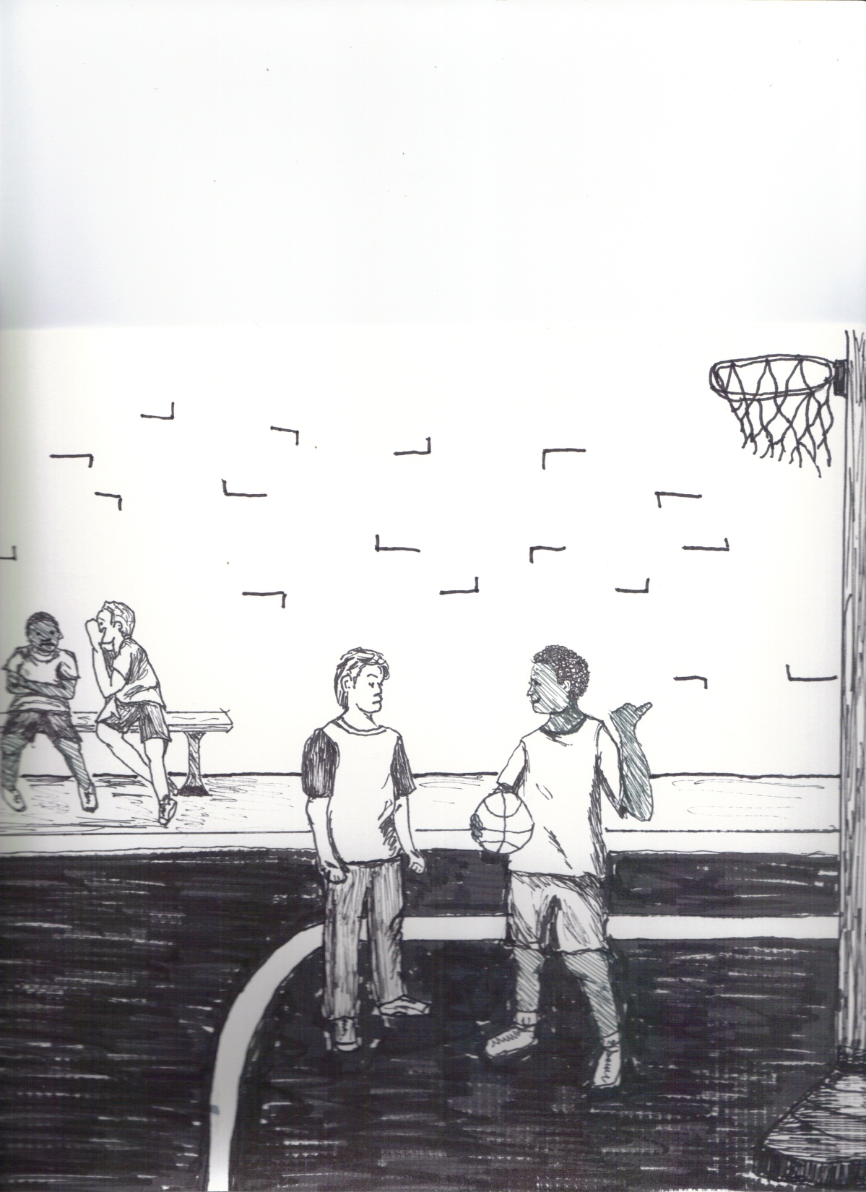
pp. 199 and 200
What is happening in this picture?

Slide 88
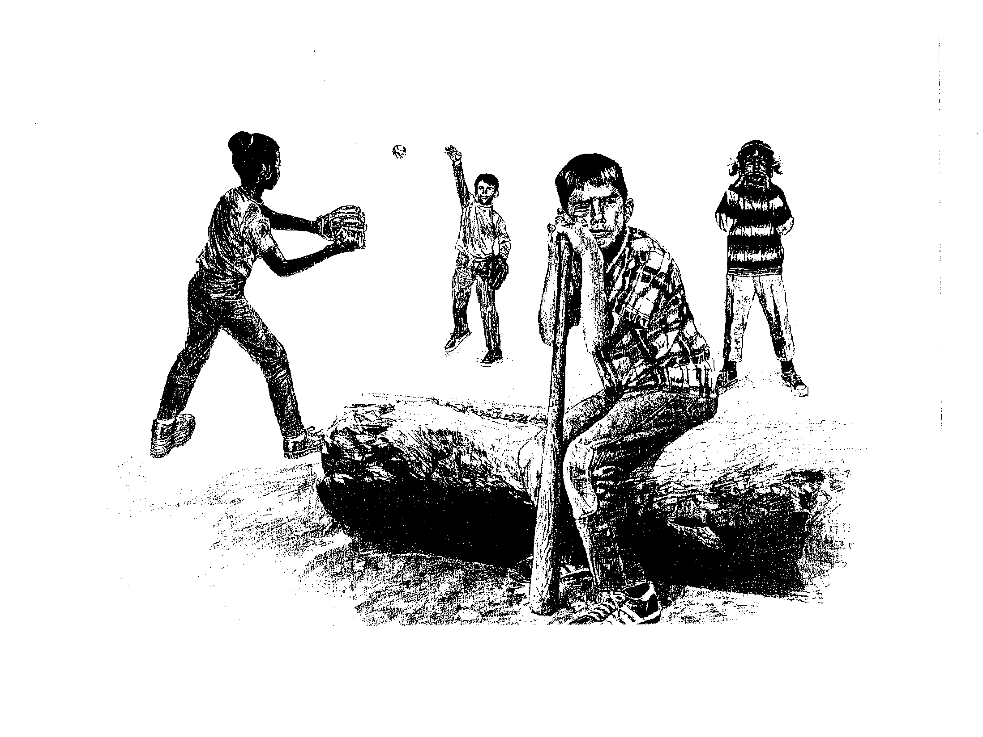
DUSO
Why is he sitting there and not playing ?

Slide 89
Session Closing Activities
Positive Feedback
  Each student says 1 positive thing about him/herself and also about person next to him/her
  Leader models appropriate compliments first
Prize Box
  Tally each student’s points
  Allow to “shop or save” (set time limit)
Free Time (optional)
    Game/snack of choice for every child who earned 1 point

Slide 90
ANGER COPING INTERVENTION
Session 2: Overview
Review previous meeting with group
Define “goal”
Explain “My Goal Sheet”
Help children determine their own goals
Help children complete goal sheets
Closing activities
Remember to send home the first Parent Letter – English or Spanish – at the end of this session

Slide 91
ANGER COPING INTERVENTION
Session 2: Goal Setting
Teach concept of both “goal” and “goal setting.”
Members generate behavioral goals around problem issues in school
Teacher input is important - “Classroom Goals Interview” form can be helpful
Discuss, complete, and sign Anger Coping Agreement

Slide 92
My Goals
1. A goal is something that I want and something I am willing to work for.
2. A goal is real and possible for me
My Goal for this week is: __________________________________ for ___ out of___ days
To achieve this goal, I must:
_____________________________________
_____________________________________
Day 1 Day 2 Day3 Day 4 Day 5 Day 6
___ ___ ___ ___ ___ ___
Signed,
____________________
Signed,
____________________ Date____________

Slide 93
Short and Long Term Goals
Make the basketball team

Slide 94
Short Term and
Long Term Goals
Make the basketball team
Reduce suspensions so eligible to play
Resolve problems without fighting
Get in fewer fights this week
Keep hands and feet to myself in P.E.

Slide 95
Session 3 & 4-
Anger Management
Anger is understood as both normal and dimensional in expression
Objective is to give the children a greater sense of personal control by helping them to understand and use the thoughts-feeling-behavior connection
Sets the stage for self-instruction use throughout the program

Slide 96
ANGER COPING INTERVENTION
Session 3: Overview
Review last session and Goals
“Too Few Puppets” problem
Introduce self-talk, distraction, and self-calming
Puppet taunting activity
First Generalization task
We are trying to help the children learn to generate the time for a deliberative
problem-solving style

Slide 97
ANGER COPING INTERVENTION
Session 3
Have the children practice distraction (“Imagine being at the most fun place in the world!) and long, slow breathing
Explain the puppet taunting activity
  Stay behind the line
  No obscene language, no racial or sexual slurs
  Decide about “your mama” taunts

Slide 98
Anger Management Training:
Sample Self-Statements
Stay calm. Just relax. Be cool. Chill.
As long as I keep my cool, I’m in control.
What she says doesn’t matter.
I’ll grow up, not blow up.
It’s too bad he has to act like this.
I don’t need to prove myself to any one.

Slide 99
Taunting Activities
4 feet
Or…

Slide 100
ANGER COPING INTERVENTION
Session 4: OVERVIEW
Obtain cards and dominos
Goals, then review insights from puppet taunting- Can they demonstrate and verbalize the concept?
Do card recall and domino line taunting activities
Do circle taunting activity
Assign Generalization task
Closing procedures

Slide 101
ANGER COPING INTERVENTION
Session 4
OBJECTIVE 2 – Practice Self-Control
10 card array with 15 second “pre-taunt”
  Same taunting rules as puppets
5 second exposure while being taunted
Tauntee writes numbers (not suits) on paper
  Debrief each: e.g., “How did you concentrate?”
Repeat with domino tower
Repeat with circle taunting ala’ puppets

Slide 102
ANGER COPING INTERVENTION
Session 4
Titrate the taunting as necessary (see next)
Debriefing each child after participating is critical for you to gather level of learning
  Practice, practice, practice…
  Note modification suggestion for girls
Leave time for de-compression!
Emphasize the Generalization task as an expectation not a suggestion!

Slide 103
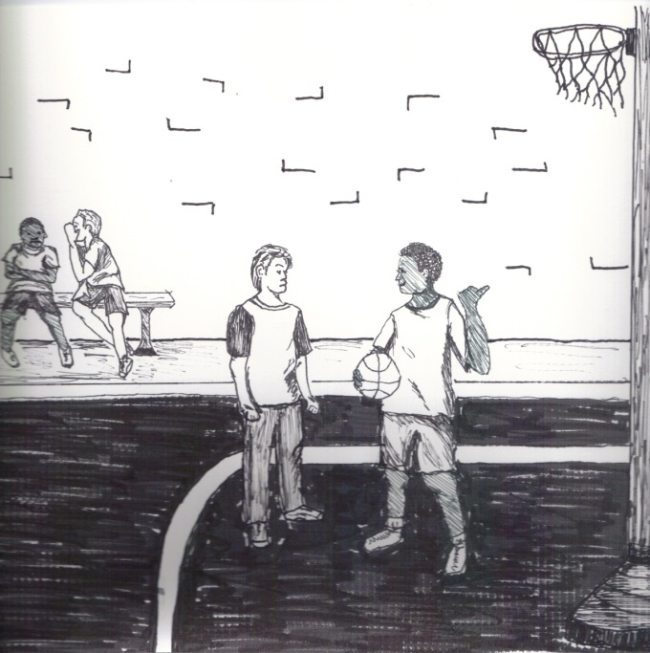

ANGER COPING INTERVENTION
Session 5:OVERVIEW
Goals, Review, and Generalization discussion
Use a stimulus picture to gather group opinions about “what the problem is.”
Do role plays from stimulus pictures
Closing

Slide 104
Session 5: Perspective Taking
Rationale:
  Helps with problem solving
  Helps children evaluate and modify their hostile attribution biases
  Helps increase empathy and concern for victim suffering
Skill Deficit:
  Attending to verbal and nonverbal cues to try to identify other people’s motivation
  Generating a range of possible attributions about other people’s motivations

Slide 105
ANGER COPING INTERVENTION
Session 5: Different Perspectives
Goals, review, then use manual, DUSO, or Second Step card to elicit "what the problem is," with each member coming up with a different idea
Comment on multiple perspectives
Do “roving reporter” activity with members in various picture roles
Elicit “point of view” perspectives

Slide 107
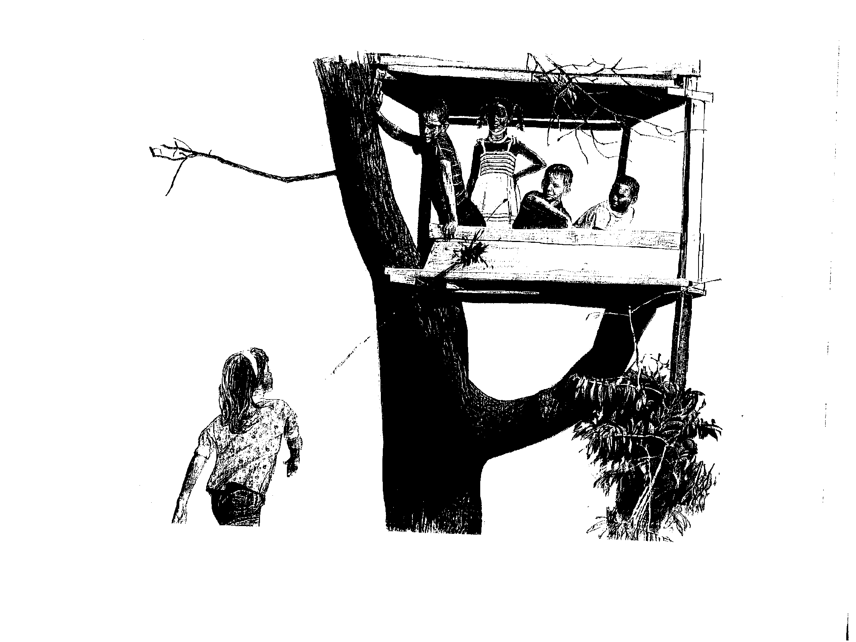
Why is she throwing a tomato ?

Slide 108
ANGER COPING INTERVENTION
Session 6:Looking at Anger Overview
Repeat roving reporter activity with a stronger focus on the issue of anger
Objectives are to help group members get a better understanding of anger as a distinct feeling and understand others’ perspectives in anger situations
“Anger” is defined
Hassle Log is introduced

Slide 109
ANGER COPING INTERVENTION
Session 6: What Does Anger Look Like?
Goals, review, then members role play an incident involving anger
Discuss the features of anger in role-play(s) - facial features, body language, what they said or did
Get a consensus definition of anger
Generate discussion of anger triggers among children
Introduce Hassle Log

Slide 110
HASSLE LOG
WHERE WAS I?
__In class __In the gym __In the hall __In the lunchroom __In the restroom __ By my locker ___ (Where?)_____
WHAT HAPPENED?
__Someone hit or pushed me __Someone took something of mine __Someone provoked me __Someone showed me disrespect __Someone threatened me __(Other)
WHO WAS THE PERSON?
__Student __Teacher __Administrator __Aide __(Other)_____________
WHAT DID I DO?
__Hit or pushed them __Used anger control __Was verbally aggressive __Walked away, left __(Other)___
HOW ANGRY WAS I? (Circle Number)
Furious! Pretty Upset Irritated Annoyed, but okay
10 9 8 7 6 5 4 3 2 1
HOW DID I HANDLE MYSELF?
___Great! I controlled my anger and kept out of unwanted trouble
___Pretty well. I tried to use what I have learned
___Not so well. I got in more trouble than I wanted

Slide 111
ANGER COPING INTERVENTION
Session 7: What Does Anger Feel Like Overview
Help the group members to identify and begin an understanding of the value of physiological cues in anger control
Explore the role of cognition/self-statements and their effect on anger intensity

Slide 112
ANGER COPING INTERVENTION
Session 7: What Does Anger Feel Like?
Goals, review, then discussion of the physiological aspect of anger
Feelings as signals that they are getting angry and that there is a problem to be solved
Group “go-round”
Thoughts-feeling connection with visuals

Slide 113
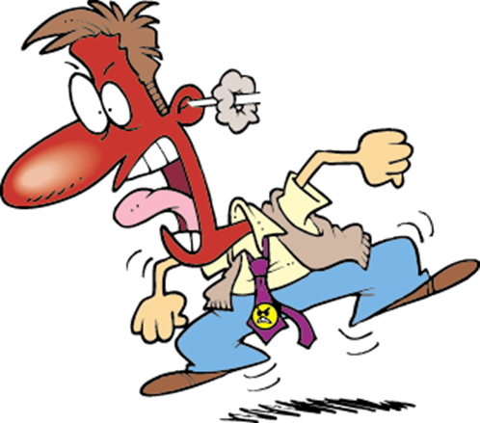
Session 7: What Does Anger Feel Like?
Anger Warning Cues
  Draw parallels to nervous & embarrassed
    Heartbeat acceleration
    Rapid breathing
    Flushing
    Muscle tension in neck or elsewhere
    Hyperactivity
    Pursing of lips, jaw clench

Slide 114
Sessions 8 and 9:
Problem Solving
Rationale: Improve students’ ability to find non-aggressive alternatives to solve social problems
Skills Deficits:
  Narrow definition of the problem (my perspective is the only perspective)
  Limited ability to generate solutions (the first and often only solution that comes to mind is aggressive)
  Limited ability to stop and evaluate possible consequences of different potential solutions

Slide 115
ANGER COPING INTERVENTION
Session 8: Problems and Choices
Goals, review, then visual of recent problems and choices made
Examine choices and decide which used anger control and what self-statements might have been used
Discuss idea of "consequences" - positive and negative
Apply to choices listed earlier

Slide 116
Social Problem-Solving:
Applying the Model
Problem Identification:
John pushes ahead of me in line at a kickball game.
What is my goal? I want my place back in line
How do I feel? I’m a little angry
Choices Consequences

Slide 117
Problem Identification: John pushes ahead of me in line at a kickball game.
Choices:
1. Call him names
2. Kick him
3. Ask him to move back.
4. Talk to the teacher.
Consequences
1. John might yell back and push. We will both get into trouble.
2. John might kick back. I will be suspended.
3. John might move.
4. John might get into trouble and be mad at me.

Slide 118
ANGER COPING INTERVENTION
Session 9:Choices and Consequences
Goals, review, then train:
What is the problem? (Problem Ident.)
What is my feeling? (Affect recognition)
What are my choices? (Response gen.)
What might happen? (Consequential Th.)
What will I do? (Decision Making)

Slide 119
ANGER COPING INTERVENTION
Session 10 through End:
Problem Solving
Objective 1: Identify Problems in School for video project
Objective 2: Desensitize the Group to Being on Camera:
Objective 3: Tape the Problem Situation:
Objective 4: Prepare for Taping of Alternatives and Consequences:

Slide 120

ANGER COPING INTERVENTION
Session 10 through End:
Problem Solving
Objective 5: Tape the Alternative Solutions:
Objective 6: View the "finished products" with comments about strengths and weaknesses.

Slide 121
Termination/Celebration
Play review game to recall and discuss skills learned
Highlight positive behavior changes in each student
Discuss how group members can use skills in future and address relapse concerns
Have a “graduation” ceremony
  Distribute personalized certificates
  Hold pizza party if earned group reward

Slide 122
Maintenance and Relapse Prevention
Schedule booster sessions
Use relapse prevention reminder tactics
  room/locker signs (”Stop and Think!”)
  hassle logs to GA’s or other responsible adults
  self-talk to manage mistakes
Re-invigorate generalization agent roles and provide them additional support as necessary

Slide 123

TREATING ADOLESCENTS USING THE
THINK FIRST PROGRAM

Slide 124
Common “Big Ideas” of AC/TF
Anger recognition
  Anger cues in self and others
Anger regulation
  Reducers and self-instruction
Social problem-solving
  Definition, choices, consequences, action

Slide 125
Think First
Adapted and modified from Feindler & Ecton’s original Art of Self Control
Manual available from major booksellers or from the publisher
Larson, J. (2005). Think First: Addressing aggressive behavior in secondary schools. New York: Guilford Press.

Slide 126
Think First:
Training Objectives
Increase student’s capacity for personal self-control over own behavior
Increase student’s capacity for regulating personal feelings of anger
Increase student’s capacity for understanding the perspective of others
Increase student’s commitment to academic progress
Provide student with a useful problem solving methodology

Slide 127
Best Candidates
Ninth grade or strong repeater
Regular attender
History of anger-associated behavior problems
School discipline structure ineffective
Connected to school in some manner, such as sports or clubs
No serious mental health or AODA issues
POTENTIAL for CHANGE

Slide 128
Screening Aids
Current Behavior Screening Form
Intervention Record Review
Adolescent Interview
Brief Problem Assessment Interview

Slide 129
Think First
Five Training Modules
  Knowledge Level
  Skill Level
Built-in assessment strategies trigger advancement in training (Checking It Out)
Treatment length mediated by observed knowledge and skill acquisition and progress monitoring data

Slide 130
Similarities and Differences from Anger Coping
Content is more alike than different, but therapeutic approach with adolescents is very different, of course
Need for greater collaborative style
Generally, less concern for behavior management issues
Potential for increased cognitive restructuring strategies
Stakes are typically higher
Parental influence may be lessened
Outside influences – AODA, delinquency, social issues – different and often greater

Slide 131

Think First Skill Areas
Anger cue recognition
Palliative anger regulation
Self-instruction in anger regulation
Problem definition
Problem response generation
Problem response enactment

Slide 132
Session Structure
Reinforce attendance;
Assign points for classroom self-monitoring/Teacher Reports
Fill-out a hassle log on an event that occurred since the previous meeting;
Through active role-play, address one or more of the most salient hassle log issues, practicing new knowledge and skills,
Review knowledge and skills from previous meetings;
Introduce new training;
Assign homework or challenge tasks;
Close with snack reinforcer and relaxation exercise

Slide 133
Module Organization - 1
Preparation
Outcomes. Each Module has desirable learning outcomes that may be used to guide decisions about movement through the training elements. The Outcomes are subdivided into Knowledge and Skills.
Functional Vocabulary Examples include:
  Confidentiality Choice Consequence Irritated Annoyed Furious Anger Cue Trigger Intention Hostile

Slide 134
Module Organization - 2
Comment This section contains introductory observations about the content of the Module to come as well as any necessary review of research relevant to the training procedures.
Trainers’ Hints This is the section that contains “wheels that have already been invented” and is designed to provide first-time trainers with ideas and proactive strategies to assist in effectiveness and efficiency.

Slide 135

Think First Module I
Introductions, Housekeeping
Behavioral Rules

Slide 136
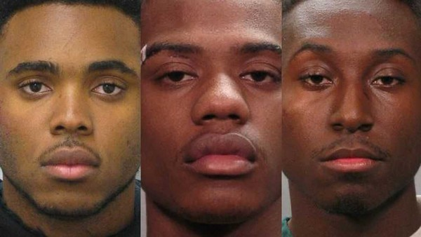
Module 1 Overview
Introductions and housekeeping
Rules and confidentiality issues
Personal Choice Behavior
The A-B-C’s of Behavior
Two progress assessments

Slide 137
Module 1-Trainers’ Hints
Suggested responses to resistance
Model Rules
Bring snacks
Get school grant to purchase supplies
Get prize donations from local merchants
  “Free pizza slice” from kitchen staff
Plan a group activity for end
  Lunch out, video, pizza delivered

Slide 138
Think First Module I continued
Model Behavioral Rules
  No physical contact between group members
  Allow everyone to express his or her opinion without interrupting
  What is said in here stays in here, except as explained by (Trainer)
  No racial or sexual slurs
  No group member put-downs, except in role-plays
  Attend all meetings or have a valid excuse signed by an adult

Slide 139
Think First Module I continued
Point System
Confidentiality – Mandated Reporter Issues
Training Goals and Think First Agreement
Academic Self-Monitoring

Slide 140
Academic Self-Monitoring
Name________________________________ Week of__________ to __________
Class:___________________________ Check all that apply this week:
o No unexcused absences
o All homework turned in
o Asked questions
o Positive comment to teacher
o _________________
Class:___________________________ Check all that apply this week:
o No unexcused absences
o All homework turned in
o Asked questions
o Positive comment to teacher
o _________________
Class:___________________________ Check all that apply this week:
o No unexcused absences
o All homework turned in
o Asked questions
o Positive comment to teacher

Slide 141

Think First Module I continued
Personal Choice Behavior (PCB)
  Locus of control inward
  Choice vs. Have to

Slide 142
Think First Module I continued
  Teach Personal Choice Behavior (P. 111)
  Ask for list of “choose to’s” and list of “have to’s”
  Challenge the “have to’s”
    Is it POSSIBLE to NOT do this?
    I don’t care if it is smart, is it POSSIBLE?
    If it is possible, it is probably a CHOICE
    Dying is NOT a choice, but how or when CAN be
    If you are locked in or chained to, you HAVE to stay there. Otherwise…

Slide 143
Personal Choice Behaviors
Have to?
Attend school
Do homework
Obey parents
Obey teachers
Obey cops
Obey laws
Get back when diss’d
Defend family honor
Choose to?
Skip school
Not do homework
Hang with friends
Drink/Use drugs
Buy $$$ stuff
Use social media
See girlfriend/boyfriend
Break the law

Slide 144
Think First Module I
Consequences
A consequence is what happens after a choice behavior
  To the chooser and to others
Consequences can be good or bad for someone, and most are fairly predictable
  People choose behaviors based upon their prediction of consequences (It will be fun, satisfying, enriching, etc.)
  Think First tries to help students learn to make good choices, thus gain good consequences

Slide 145
Think First Module I continued
A – B – C Method
  A - what triggered the problem? Led up to it
  B - what did you do? Response to "A“
  C - what were the consequences for everyone?
  Trainer Example:
A –On my way to school, slow driver
B – Got angry, sped around him
C – Got a ticket

Slide 146

Think First Module I concludes
Comprehension Check Decision Point – See Manual, p. 114
Questions and Concerns?

Slide 147

Think First Module II
Overview
Learn Hassle Log
Provide definition of anger
Understand dimensional anger vocabulary
Understand physiological anger cues
Learn palliative anger reducers

Slide 148
Module 2-Trainers’ Hints
Be sure to review and make connections
Role-plays should be realistic, serious, and always non-aggressive, reflecting new training
Dimensional anger terminology can help with anger regulation
“Anger thermometers” can be useful
Debunk “Just ignore them”
Boys and feeling state recognition

Slide 149
Think First Module II
Explain Hassle Log (Handouts p.186)
  Alter and adapt it to your situation
  Self-Monitoring, memory aid, and role play guide
  Have them fill one out now and discuss
  Afterward, beginning of every group meeting
  Provide dean or administrator with a stack

Slide 150
Think First Module II
Understanding Anger
Write “anger” on chalkboard or piece of paper
“Think of a time when you were REALLY angry. What was happening?”
  Model first, then go around (feeling, not behavior)
“What do these all seem to have in common?”
  Did not like what someone said or did

Slide 151
Think First Module II
Understanding Anger
Seek agreement on what the purpose of anger is: Fear – Protect from harm. Anger??
  Scare, stop them from messing with you, send a message (recall Day 1 workshop)
Ask: When is anger good and when is it bad? (see p. 120)

Slide 152
Think First Module II
Understanding Anger
Teach anger continuum of intensity
Solicit terms, but include “irritated” and “annoyed”
Complete MSAI activity (P. 171)
Model and ask for “irritating” events and events occasioning rage or fury
  Compare consequences following each

Slide 153
Anger Thermometer
Kassinove & Tafrate, 2002

Slide 154
Think First MODULE II continued
Anger Cues
  Physiological warning signs for the need to regulate
  Draw parallels to nervous & embarrassed
    Heartbeat acceleration
    Rapid breathing
    Flushing
    Muscle tension in neck or elsewhere
    Hyperactivity
    Pursing of lips, jaw clench
Anger Reducers

Slide 155
Think First Module II
Anger Reducers
“Purpose is to give you time to make the right choice when quickness is not critical”
  A choice in your best interest
Role play one of the group members refusing to return to seat when asked and talk through anger cues (“I can feel…”)
Train “Deep Breathing” and “Backward Counting” using role-plays on p. 123

Slide 156
Incident + Cue + Anger Control
I got pulled over but I was only 5 MPH over. I felt my face get warm and muscles tighten as I saw him sitting in his car behind me. I took some long, slow breaths.
Person express lane had too many items and was demanding price checks. I felt my heart start to beat harder and faster. I began counting backwards.

Slide 157

MODULE II concludes
Allow students to role play provocation PLUS anger cue PLUS anger reducer
Comprehension Check Decision Point
Complete Checking It Out II-1

Slide 158
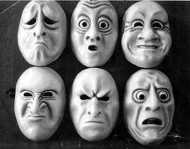
Think First Module III
Overview
Understand, describe, and identify own most problematic external anger provocations (Anger Triggers)
Understand, describe, and identify own most common Thought Triggers
Differentiate the features of intentional hostility from other intentions

Slide 159
Think First Module III
Trainers’ Hints
Start Progress Monitoring Report
Use hassle logs to stimulate role plays using skills learned to date
Use school-related anger triggers only
Avoid too much depth with thought triggers but reference them later
  E.g., “What were your thought triggers when ___________ happened?”

Slide 160
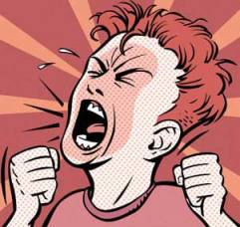
Think First Module III
Anger Triggers – Who, What, Where?
  Often A in A-B-C
  Commonalities?
  PCB and triggers – What can you do?
Thought Triggers
  Awfulizing Triggers
  Demanding Triggers
  Overgeneralized Triggers
  Name-Calling Triggers

Slide 161
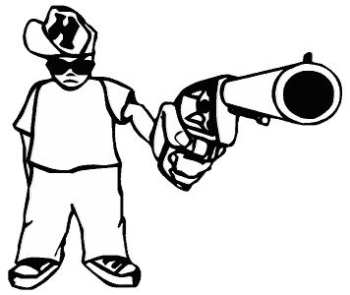
Module III continued
Comprehension Check Decision Point –
Complete Checking It Out III-1
Attribution Retraining
Hostile attributional bias
Understand definition of “intention” and “hostile”

Slide 162

Module III continues
Discuss importance of understanding intent and how to judge it
  Nonverbal cues
    Facial expression, body posture
    How does a hostile person look? Stand? Behave?
  Context
    What’s been going on up until now? Loose or tense?
    Who else is there? Does the person need to save face?

Slide 163
Module III concludes
Comprehension Check Decision Point
Complete Checking It Out III-2
Questions and Concerns?

Slide 164
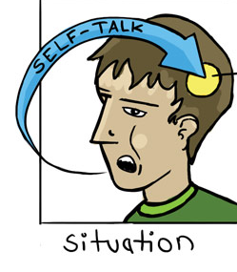
MODULE IV
Self-Instruction and Consequential Thinking - OVERVIEW
Understand concept of self-instruction (“Reminders”) and their use in anger regulation
Identify times when reminders can be used
Introduce consequential thinking as a way to avoid unwanted trouble

Slide 165
MODULE IV
Trainers’ Hints
Anger control does not mean “fear of fighting.”
  “Code” issues in and out of school
  The rare “spontaneous fight”
  More choices means more power
Thinking Ahead – Watch for unrealistic and unlikely responses that provide the “right answer.” Challenge them.

Slide 166
MODULE IV
Self-Instruction
  Staple in CBT since Meichenbaum 1972
  Externalizing vs. Internalizing differences
  Makes use of a natural human behavior by focusing it productively
  Analogies to anxiety/fear – Remember when you used it?
  “Remind” ourselves to stay calm in pressure or anxiety provoking situations

Slide 167
  MODULE IV continued
Model anger reducer PLUS reminder
  “I take a long, slow deep breath and say to myself…”
  Before – When you can anticipate
    “You can do this…”
  During – To keep your cool
    “Chill, take it easy…”
  After – Self-reinforcing or self-coaching
    “Good job, man!” or “I need to practice more.”

Slide 168
MODULE IV continued
Complete taunting exercise a minimum of 5X’s
  Why practice?
  Write reminders on 3X5 card
  Tape lines 4 feet apart
  30 seconds of “before” reminders
  30 seconds of taunting within the rules
  Handshakes and debriefing
  Trainers model first!

Slide 169
MODULE IV continued
Consequential Thinking
  Part of George Spivack’s interpersonal cognitive problem-solving (ICPS) skills
  Ability to think of different things that might happen in a situation
Explain “thinking ahead” and discuss as “If…then…” scenarios
  If I (misbehave) now, then I will (negative consequences)

Slide 170
MODULE IV continued
Brainstorm all the positives and all the negatives that come from fighting
Differentiate short- and long-term consequences
On board, write reminder + thinking ahead + goal-directed behavior
  “What is my goal here?”
  Calm yourself, think first, then act

Slide 171
MODULE IV concludes
Clients complete “If I… then… So I will” exercise
“Be cool. If I shove him, then he’s gonna come back at me. So I will tell him this ain’t worth a suspension and walk off.”
  Reminder + thinking ahead

Slide 172
Module IV concludes
Comprehension Check Decision Point –
Complete Checking It Out IV-2
Questions and Concerns?

Slide 173
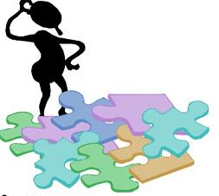
MODULE V
Social Problem Solving - Overview
Training the skill of breaking down interpersonal and other conflicts into solvable problems
“Problems” are defined and the steps to problem-solving trained
Group members address at least one major school problem

Slide 174
MODULE V
Social Problem Solving
STOP AND THINK: WHAT IS THE PROBLEM?
WHAT CAN I DO?
WHAT WILL HAPPEN IF?
WHICH SHOULD I CHOOSE?
NOW DO IT!
HOW DID I DO?

Slide 175
MODULE V
Trainers’ Hints
Use authentic problems as much as possible for training
Remember the need for behavioral skills training throughout
  Don’t just tell us what you are going to do, show us
Convey “challenges” as a motivating tool
  See top p.147

Slide 176
MODULE V continued
STOP AND THINK: WHAT IS THE PROBLEM?
  Help them learn to own the problem
    Not another’s behavior, but my response to it
  Goal and obstacle construction
“I WANT to stay out of trouble (goal) BUT my enemies keep hassling me (obstacle)

Slide 177

MODULE V continued
The Cousin Problem
“Imagine you are about to go into school for first period when your cousin runs up and begs you to go help find some guys who were threatening him on the way to school. You have an important test first period that you studied for and know you can pass, but he’s your cousin and he could get hurt.”
What is my problem?

Slide 178
MODULE V continued
Practice problem definition (“I want… BUT…”)
Comprehension Check Decision Point –
Complete Checking It Out V-1 (p. 121 in Handouts)

Slide 179
MODULE V continued
Step 2: WHAT CAN I DO?
Problem generating alternative solutions
Start simple:
  I want to watch my TV show, but my sister is watching her show. What are all the things I could do?
Play the “What Can I Do?” Game for two or more meetings
  Manual, p. 150 -151
  Alternatives must be possible
  Use other locally relevant problems

Slide 180
MODULE V continued
What can I do?
You are eating lunch and a student you don’t like walks by and whispers, “Punk.”
A teacher accuses you wrongly of writing a gang symbol on the bathroom wall.
A friend comes by school with a car he peeled and stole, and suggests you go for a ride with him.

Slide 181
MODULE V continued
Assist group to understand meaning of “anticipate”
  Encourage realistic consequences
Complete “Worst” and “Most Likely” exercise
  If I do (this):
  What is the worst that could probably happen?
  What is most likely to happen?

Slide 182

Worst and Most Likely
Another student makes an insulting remark about your mother while the two of you are getting dressed after gym
  You bust him up good
    Worst and Most Likely
  You ask him if he was playing or serious?
    Worst and Most Likely

Slide 183
MODULE V continued
Practice “What will I do?” using the first four problem-solving steps
  Do they have the skill required at the “Now Do It!” step?
    Can you do that? What do you mean by…? Show me how you would do that.

Slide 184
MODULE V completed
Have students’ analyze own problems with Handout V.3
Provide multiple opportunities for problem-solving in authentic context
Self-evaluation and managing set-backs addressed

Slide 185
When Formal Curriculum is Finished
Two weeks prior, brainstorm a suitable conclusion ceremony
  Students may invite adult of choice
  Invite administrator(s) and selected others
  Ask each student to prepare a short written statement: “What I Learned and How I’ve Changed”
  Provide Certificates of Completion

Slide 186
When Formal Curriculum is Finished
Set dates for follow-up booster sessions
Emphasis is on authentic, ongoing issues in the school setting
Continuing skill development through role-plays and behavioral rehearsals
  What is the problem and how will you address it?
  Practice, Practice, Practice!

Slide 187
Maintenance and Relapse
Have students right down self-reminders to guide behavior, e.g.:
  “Avoid door 3 in the morning”
  “Think ahead before acting”
  “Use my reminders in gym class”
Anticipate possible problems and help with management
  How will you think about it?
  What will you do to bounce back?

Slide 188
Therapeutic Interviewing using
Problem-Solving Discourse
Strategies by Donald Meichenbaum for working with aggressive adolescents

Slide 189
Three Levels of Social and Emotional Support in School
INDICATED
SELECTED
UNIVERSAL
FEW
Individual Clinical Support - PSD
SOME
Anger Coping & Think First
ALL
SEL & Discipline
Notes:
189
?
At the SECONDARY level, we are concerned with those students who are showing signs or symptoms of mental health problems. What do these students need know and be able to do to stop or reverse the progression of the problem?
At the TERTIARY level, we are concerned with the needs of those students with severe and pervasive mental health problems. These students are typically, but not always, is special education. We are concerned with assisting in the teaching of coping skills and facilitating transitions.

Slide 190
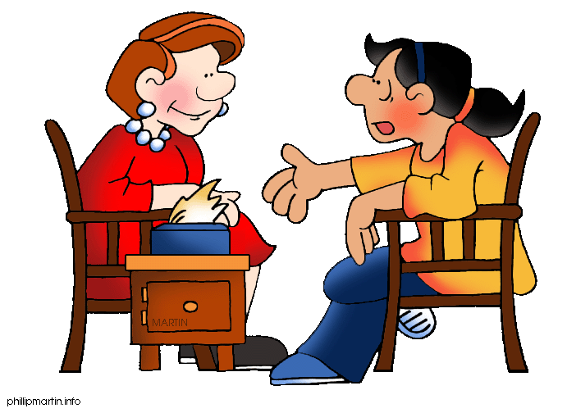
Tier 3 Support
Student is emotionally/behaviorally incapable of functioning in a small group
…….OR
Student needs more intensive services than can be found in group work

Slide 191
Working with Individual Adolescents
General Considerations
Establish collaborative relationship
  How can we work together?
Respect the youth’s perspective
  Get student to convince you of its authenticity
Take a solution-focused approach
  Instill hope, a way out
Foster responsibility
Enact a plan

Slide 192
Problem-Solving Discourse Meichenbaum, 2008
A “Phase-Oriented Problem-Solving” process to help angry youth become better problem-solvers;
Follows a “discovery training” model
Helps teach a variety of coping skills and problem-solving vocabulary

Slide 193
Problem-Solving Discourse
PHASE I - PREPARATION
  Collaborative alliance, defuse emotions, obtain timeline of aggressive event
PHASE II - PROBLEM-SOLVING PHASE
  Consider and develop more prosocial alternatives and assume more responsibility
PHASE III - IMPLEMENTATION
  Practice and apply new skills

Slide 194
PSD
PHASE I - PREPARATION
If necessary, defuse the situation and de-escalate the anger
Explore the “what, when, where, who” of the present incident – “mental videotape”
Conduct a behavioral chain analysis that connects feelings, thoughts and behaviors
  How did you feel when that happened to you?
  What went through your mind at that point

Slide 195
PSD
PHASE I - PREPARATION
Emphasize choice behaviors
  How did you come to choose (decide) to do … ?
  What happened after you made the choice to …?
Summarize student’s view of the event
  Correct me I’m wrong, but what I hear you saying is…
Nurture hopefulness, a way out
  Let's see if we can make sense of what happened to you

Slide 196

THIS VIDEO DEMONSTRATION…
Highly compressed timeframe
Remarkably cooperative client!
Watch/listen for major objectives
  Thoughts and feelings connection
  Moving locus of control inward
  Taking perspective of other
  Considering alternatives
Tender Ears Advisory…

Slide 197
PSD
PHASE I - PREPARATION
VIDEO

Slide 198

PSD
PHASE I - PREPARATION
What did you observe?
What more do you want to know about this youth?

Slide 199
PSD
PHASE II - PROBLEM SOLVING
Help the client take the perspective of others
  What was going through his head when he saw you?
  If you were thinking that, would you have done the same thing?
Help the client generate causal explanations
  Why do you think he got so mad about that?
  What seemed to trigger the problem?
  Everything was going okay until what?

Slide 200
PSD
PHASE II - PROBLEM SOLVING
Help the client generate alternative solutions
  What other ways are there to try to solve the problem?
  Can you think of a different way so X wouldn’t happen?
Help the client notice warning signs
  How can you (or others) tell when you are first getting upset ?
Foster responsibility (ownership)

Slide 201
PSD
PHASE II - PROBLEM SOLVING
VIDEO

Slide 202
PSD
PHASE II - PROBLEM SOLVING
What did you observe?
What direction would you take now?

Slide 203
PSD
PHASE III - IMPLEMENTATION
Covey a “challenge” and bolster self-confidence
  This might be really difficult. Can you do it?
  I believe you are mature enough to face this
Generate an action plan
  What advice would you have for a friend who has this same problem?
  What has worked for you in the past?
Help anticipate consequences
  If you do…what do you think will happen?

Slide 204
PSD
PHASE III - IMPLEMENTATION
Help anticipate barriers
  Let’s suppose that…
  How can you remind yourself to…?
Reinforce effort
Help youth see the connections between action and outcomes and how he/she will benefit
  Why is it important for you to stay out of trouble?
  Do you think you can teach what you have learned to someone else?

Slide 205
PSD
PHASE III - IMPLEMENTATION
VIDEO

Slide 206
PSD
PHASE III - IMPLEMENTATION
What directions should therapy take from here?
Who else might you want involved?

Slide 207
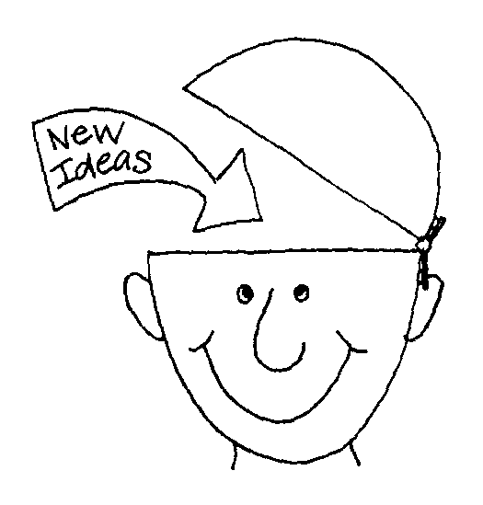
PROBLEM-SOLVING DISCOURSE: SUMMARY
Assessing how ready/willing is this youth for change
Fostering trust and collaboration
Nurturing insight and skill development
Embarking on new behaviors

